Slide 1
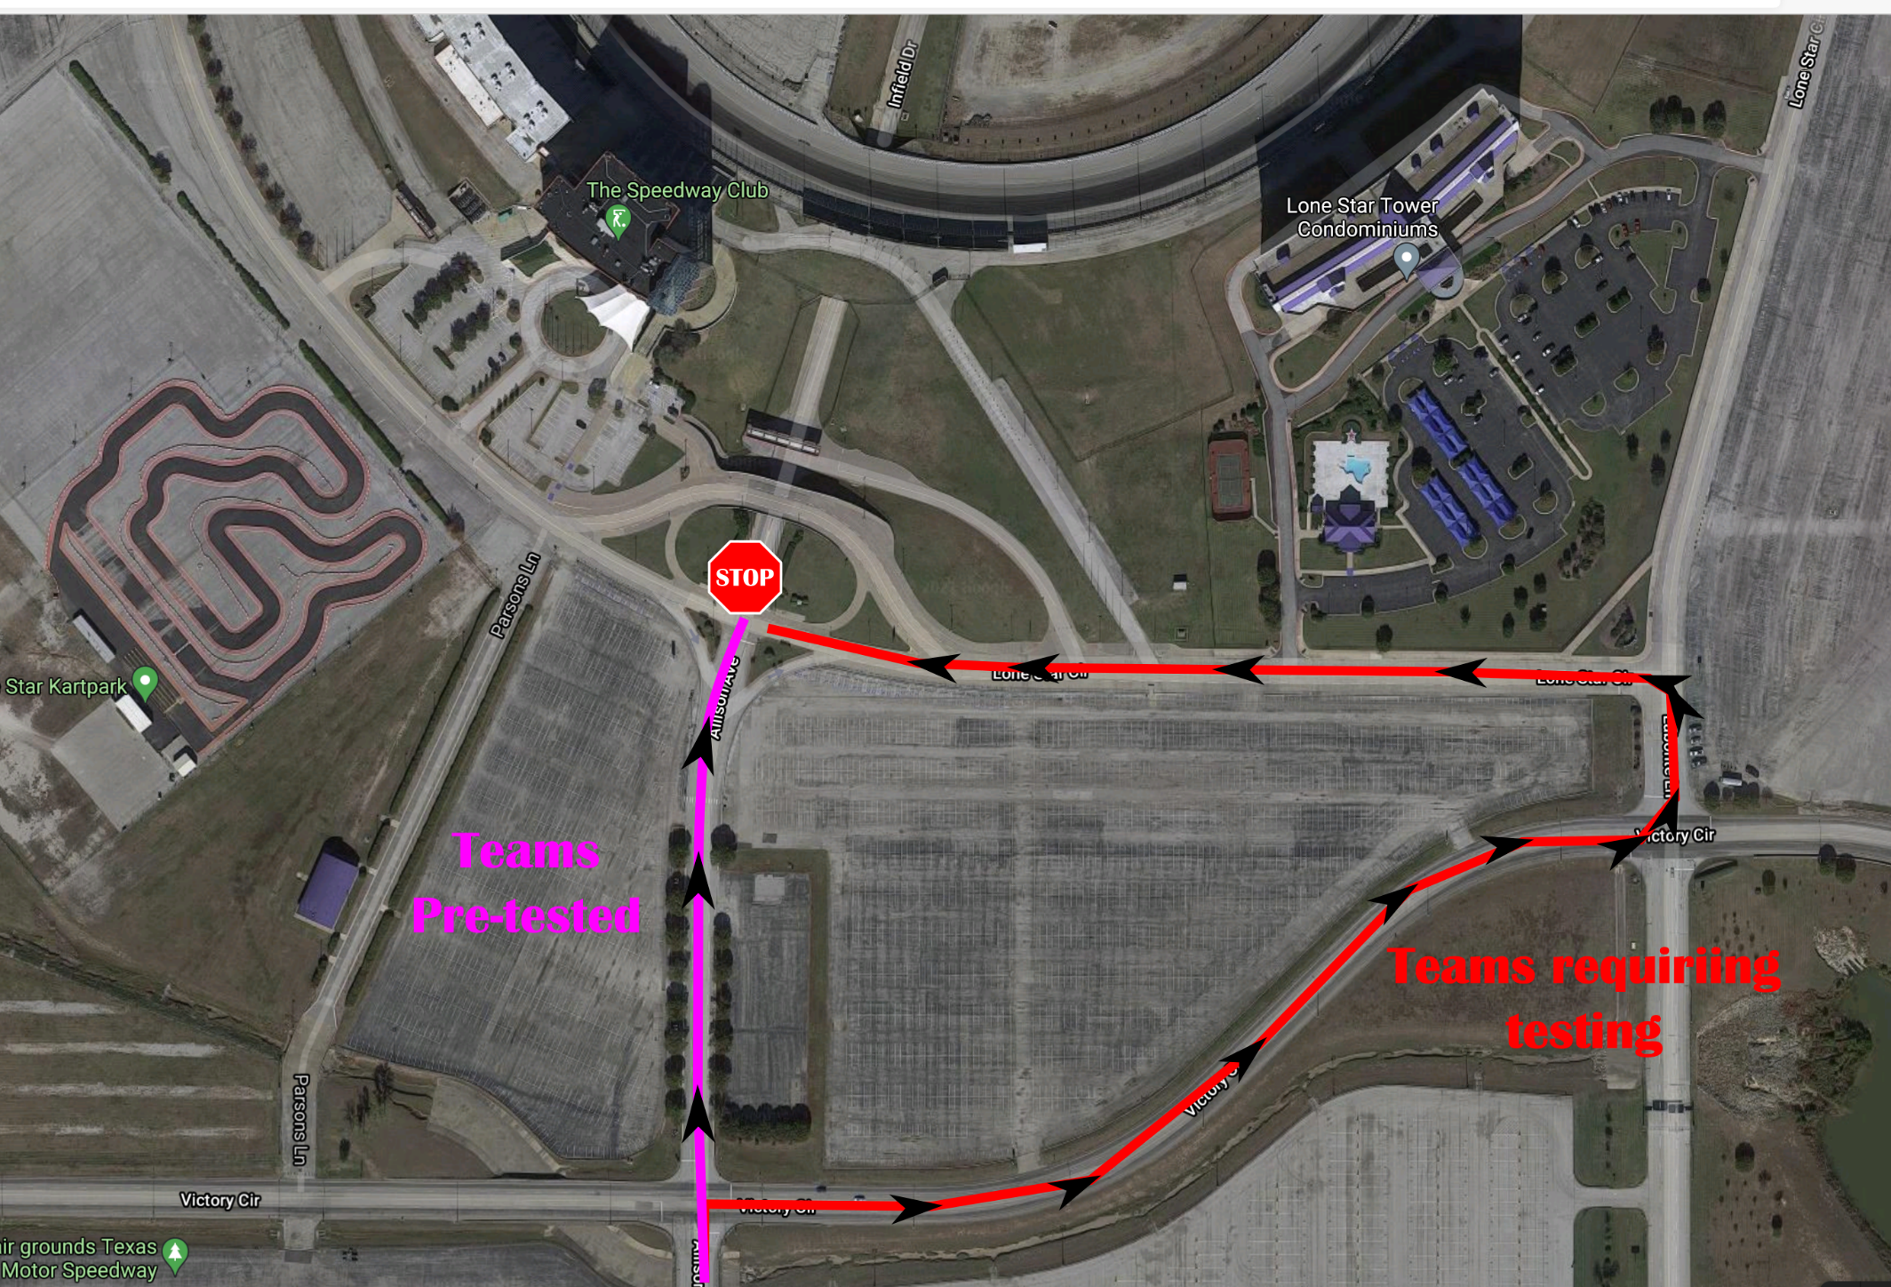

Slide 2
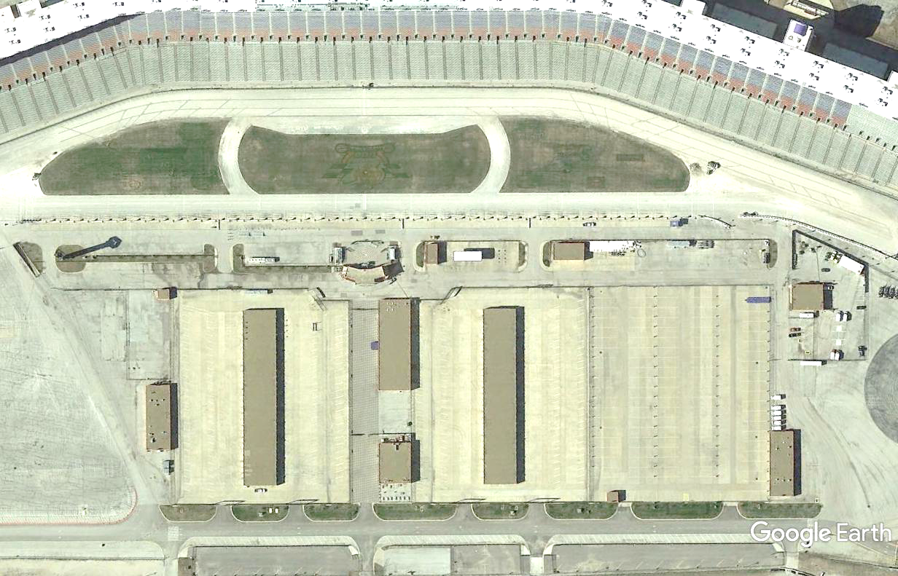
SPOTTERS
PIT LANE
ALT TRACK EXIT
TRACK EXIT
PIT SLOTS
TRACK ENTRY
SUPPORT IN/OUT
OTHER TEAM VEHICLE
PARKING
STAFF
CHARGING STATIONS
TRAILER PARKING
MEDIA CTR
SECONDARY GARAGE
SUPPORT PARKING
SUPPORT PARKING
TRAILER PARKING
PRIMARY GARAGE
STAFF
TRANSFER BETWEEN GARAGES

Slide 3
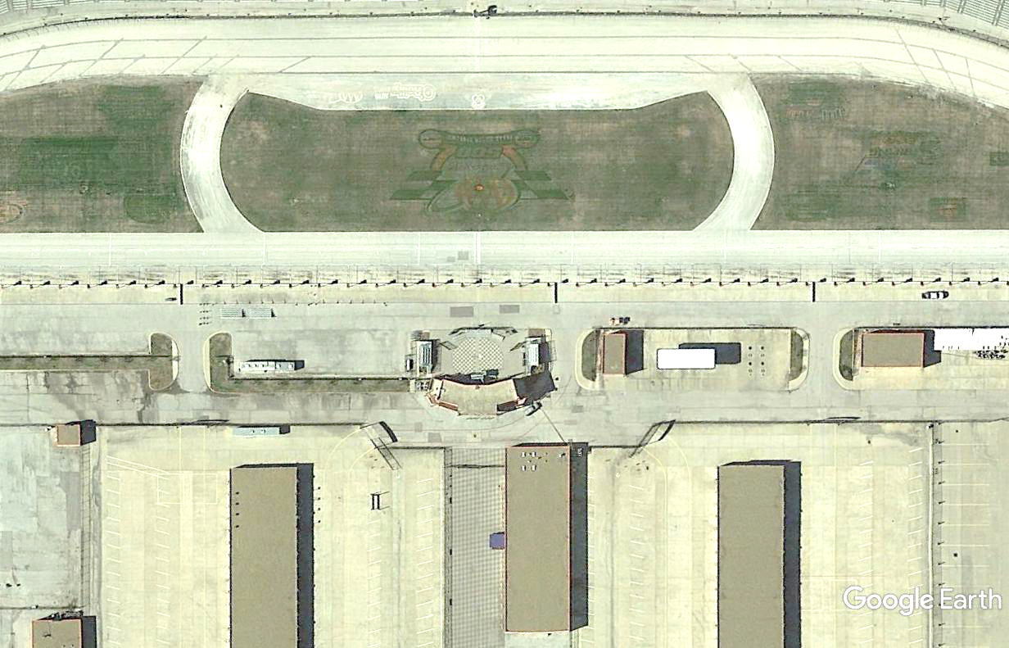
DRIVER CHANGE
ALT TRACK EXIT
DC2
DC4
(For use during Session Start)
TRACK EXIT
TRACK ENTRY
DC1
DC3
22
21
20
19
18
17
16
15
14
13
12
11
10
SC/CTL
DC
09
08
07
06
05
04
03
02
01
SAFETY
SUPPORT IN/OUT
AREA FOR SOLAR CARS & PEDESTRIANS ONLY
AREA FOR
TRAILERS & SUPPORT VEHICLES
AREA FOR
TRAILERS & SUPPORT VEHICLES
EXIT TO SECONDARY GARAGE
EXIT TO PRIMARY GARAGE
AREA FOR SOLAR CARS & PEDESTRIANS ONLY
AREA FOR SOLAR CARS & PEDESTRIANS ONLY

Slide 4
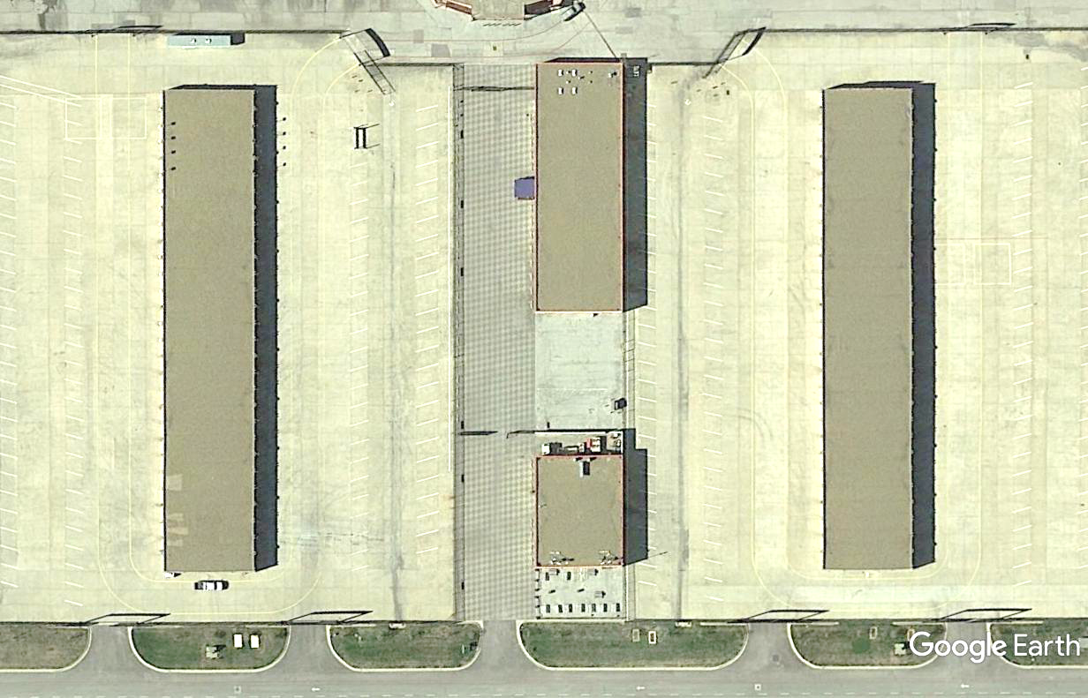
5
6
TMS
BAY
2
4
6
8
10
12
14
16
18
20
22
24
26
28
30
32
34
36
38
40
42
44
46
48
50
3
AUDITORIUM
(Staff Use Only)
WATER
TMS BAY
1
3
5
7
9
11
13
15
17
19
21
23
25
27
29
31
33
35
37
39
41
43
45
47
49
STAFF
E-S1
CHARGE
4A
4B
1A
2A
12
PHOTO
Do Not Use
1B
2B
1C
C
2C
13
E-S2
CHARGE
BATTERY EXCHANGE TRACK
14
E-S3
CHARGE
MEDIA
CENTER
01
02
AREA FOR
TRAILERS & SUPPORT VEHICLES
15
E-S4
CHARGE
AREA FOR SOLAR CARS &
PEDESTRIANS ONLY
16
03
17
04
18
8, 9
05
19
AS NEEDED IN TEAM BAY
06
20
07
21
AREA FOR SOLAR CARS &
PEDESTRIANS ONLY
08
22
09
AREA FOR
TRAILERS & SUPPORT VEHICLES
10
COVID TESTING
/ STAFF
#
11
SCRUTINEERING STATION LOCATIONS
TRANSFER BETWEEN GARAGES

Slide 5
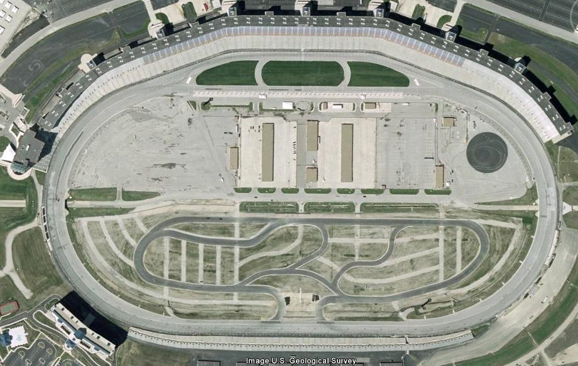
Middle
End
Front Straight
Begin
Begin
End
Turn 1
Turn 4
End
Caution Zones
Begin
Begin
End
Turn 3
Turn 2
Begin
End
Back Straight
End
Begin
Middle

Slide 6
Front Straight
Turn 1
Turn 4
Driving Line
Turn 3
Turn 2
Back Straight

Slide 7
Front Straight
3 lanes to 2 lanes, plus pit road entry; watch for cars
Left of cone for exiting track
Right of cone to stay on track
Turn 1
Turn 4
Driving Notes
After cone, drive up above white line; slower cars can optionally hug wall
Watch for merging cars (3 lanes to 2 lanes, plus cars against wall)
Turn 3
Turn 2
Back Straight

